Slide 1
First spectroscopy of ⁶⁴Cr and
the collectivity of neutron-rich nuclei at N~40
AGATA physics workshop, Istanbul, May 4-7, 2010
CEA Saclay: A. Obertelli, F. Flavigny, A. Gillibert, A. Goergen, W. Korten,
V. Lapoux, C. Louchart, L. Nalpas, B. Sulignano, Ch. Theisen
LNL: J. Valiente-Dobon et al.
GSI : H.-J. Wollersheim et al.
and the AGATA and PRESPEC collaborations

Slide 2
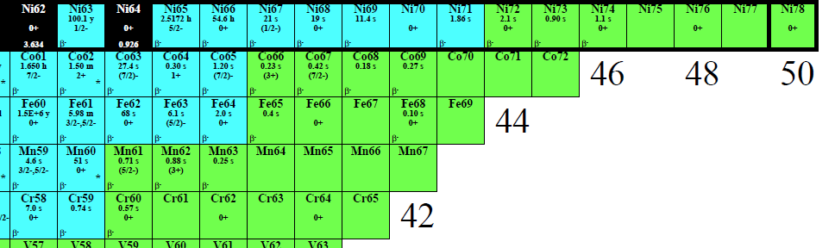
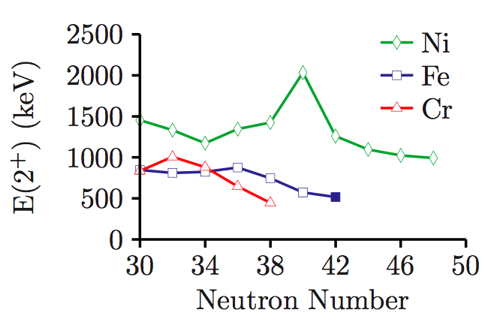
First spectroscopy of ⁶⁴Cr and
the collectivity of neutron-rich nuclei at N~40
Z=28
?
N=40
P. Adrich, Phys. Rev. C 77, 054306 (2008).

Slide 3
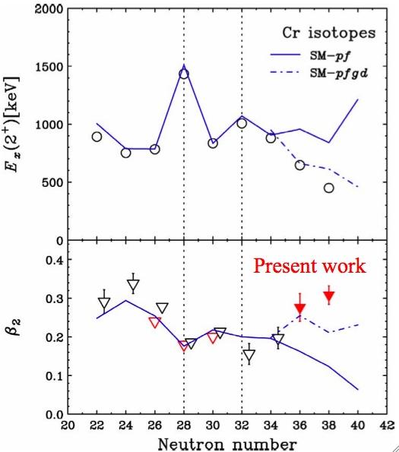
Enhanced collectivity in neutron-rich N~40 nuclei
Excitation energy of ⁶⁴Cr(2⁺) very
sensitive to fpgd shell structure
Evidence for onset of collectivity at N=40
P. Adrich, Phys. Rev. C 77, 054306 (2008).
New “island of inversion” in ⁶²Ti ?
O. Tarasov et al., Phys. Rev. Lett. 102, 064319 (2008).
not supported by HFB Gogny calculations
L. Gaudefroy et al., Phys. Rev. C 80, 064313 (2009).
established in Fe isotopes (lifetimes ^{62,64}Fe)
J. Ljungvall et al., submitted for publication (2010).
N. Aoi et al., Phys. Rev. Lett. 102, 012502 (2009).

Slide 4
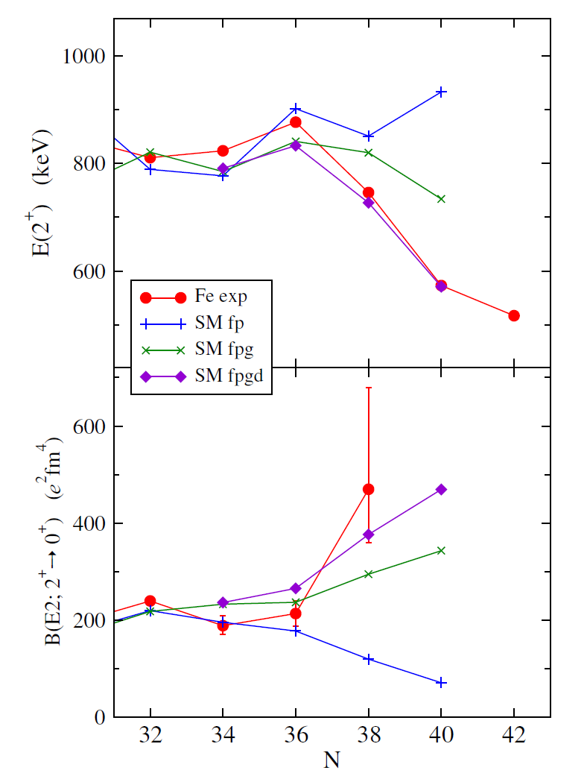
Objectives of the proposed experiment
Determine the excitation energy of the first excited 2⁺ state in ⁶⁴Cr
via ⁶⁵Mn(p,2p)⁶⁴Cr
Evolution of mass deformation (β₂) in Fe isotopes
via ^{66,68}Fe(p,p’)
Fe isotopes
Cr isotopes
N. Aoi et al., Phys. Rev. Lett. 102, 012502 (2009).
J. Ljungvall et al., submitted for publication (2010).

Slide 5
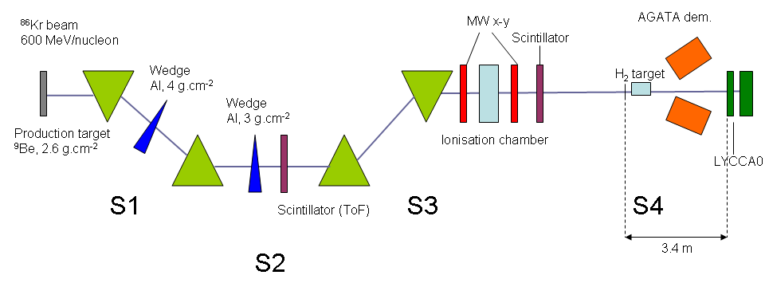
Experimental details
Rates:
10¹⁰ pps ⁸⁶Kr primary beam @ 600 MeV/nucleon
2.6 g.cm⁻² ⁹Be production target
Total rates from MOCADI simulations:
4 kHz in S2, 200 Hz in S4
12 pps of ⁶⁵Mn, ⁶⁴Mn: 43 pps, ⁶³Mn: 24 pps
5 pps of ⁶⁸Fe, ⁶⁷Fe: 22 pps, ⁶⁶Fe: 27 pps

Slide 6
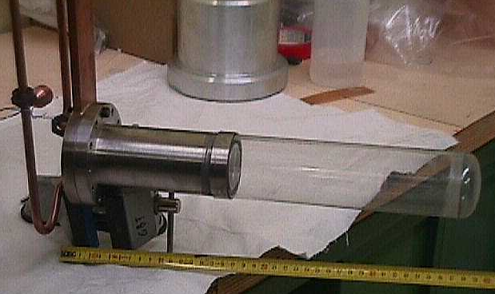
Prespec LH₂ target
New H₂ target developed at Saclay for PRESPEC
several centimetres long (60 mm = 3. 10²³ cm⁻²)
no background from Carbon
very little absorbing material around target
dedicated to (p,p’) and “knockout” on H
4 LOIs submitted using the H₂ target
N=34 shell gap: spectroscopy of ⁵³Sc / Valiente-Dobon
Onset of collectivity at N=40 : spectroscopy of ⁶⁴Cr / Obertelli
Origin of collectivity in Sn isotopes via (p,p’) / Dombradi
Shell structure of N~82 neutron-rich nuclei / Boutachkov
Test experiment (S378)
⁵⁶Fe beam (or similar) at 350 MeV/nucleon
20 UTs of parasitic beam time
to be scheduled : end 2010 – early 2011

Slide 7
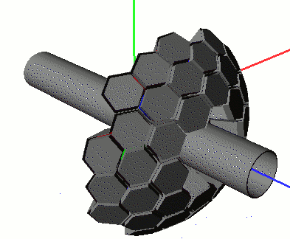
Preliminary simulations for gamma detection
Geant4 simulations (E. Farnea, C. Domingo-Pardo)
AGATA demonstrator with 10 triple clusters (no doubles)
Input
500 keV gamma-ray emitted at β=0.665-0.6725
incoming secondary beam at 300 MeV/nucleon
60 mm thick H2 target (3. 10²³ cm⁻²)
effects of varying gamma emission points are taken into account
Energy resolution
Efficiency
AGATA S2 (10 triple clusters)
30-40 keV
8-10 %
RISING (Euroball clusters)
60 keV
4 %

Slide 8
Beam time request
Input
12 pps ⁶⁵Mn / 5 pps ⁶⁸Fe
5 days of secondary beam time on target
60 mm H2 target
σ(p,2p)=3.5 mb / σ(p,p’)=4.5 mb
AGATA: 12% photopeak efficiency
Final statistics (photopeak)
⁶⁴Cr(2⁺): 580 counts / population of 4+ possible
⁶⁸Fe(2⁺): 300 counts

Slide 9
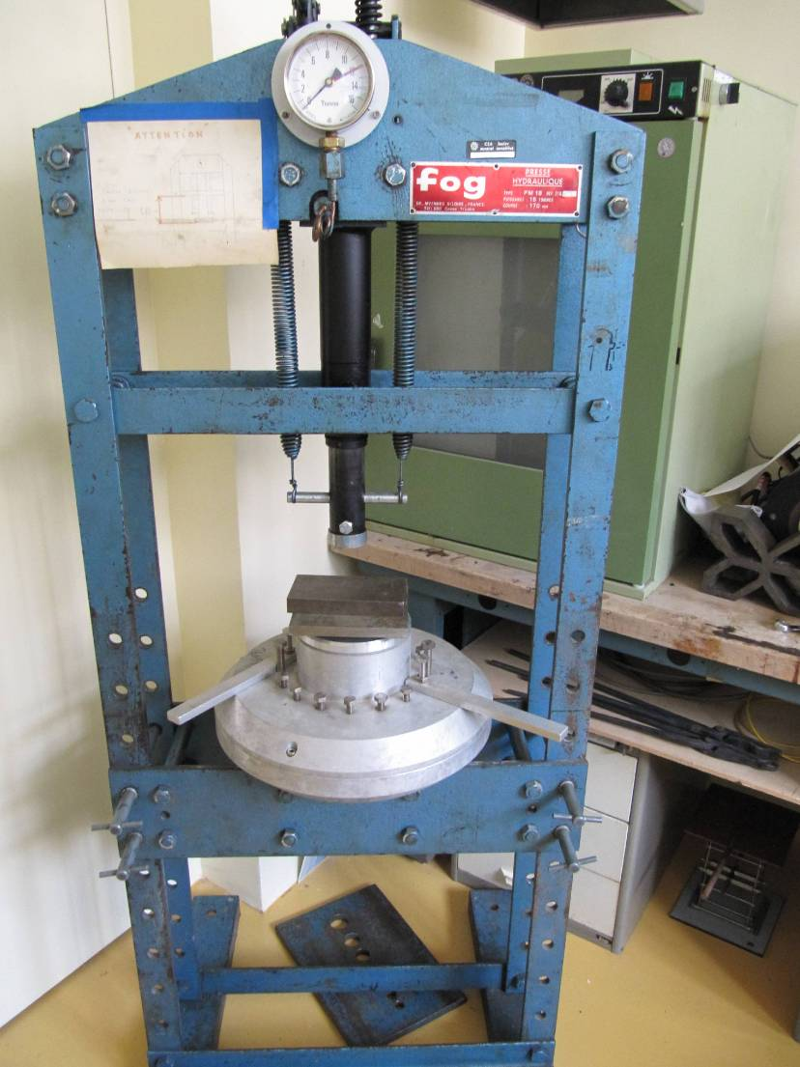
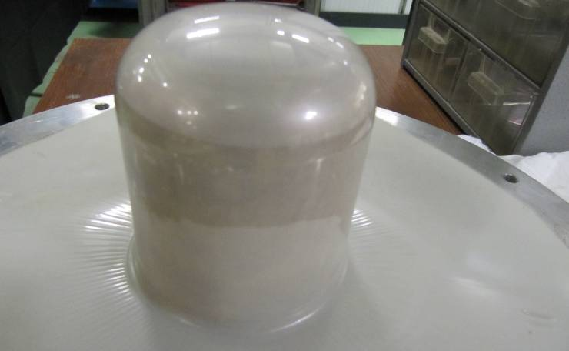
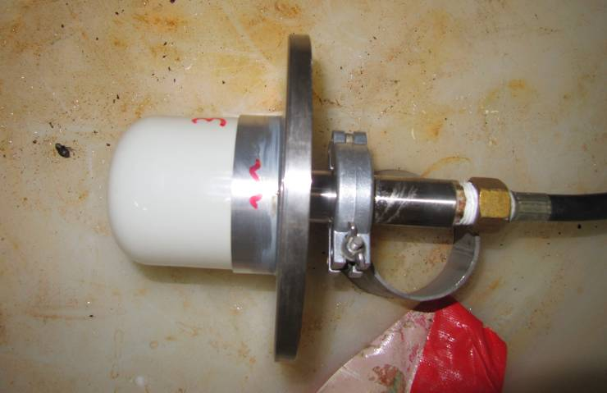
Target cell
Team
O. Louchart (technician)
Ph. Chesny , J.-M. Gheller, J.-Y. Rousse (engineers)
W. Korten, C. Louchart (PhD), A. Obertelli
Mylar cell (250 μm)
resistance test (water)
oven & press

Slide 10
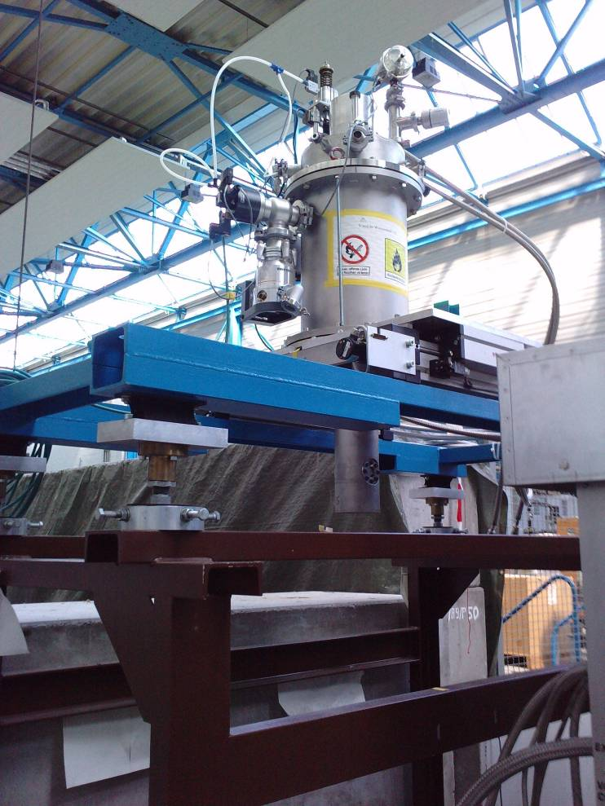
Design and installation
Central axis of the cryostat
976 mm
129 mm
Ø 324 mm
454 mm
Bride Iso F DN 320 mm
125 mm
General support (GSI)
385 mm
Ø 150 mm
beam
Beam axis
686.6 mm
Target Ø 70 mm
2188 mm
575 mm

